Slide 1
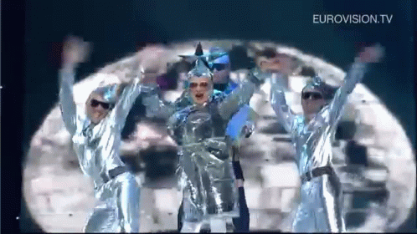
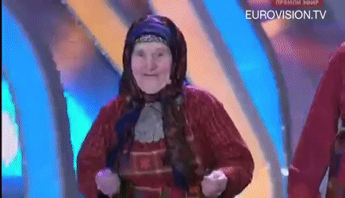

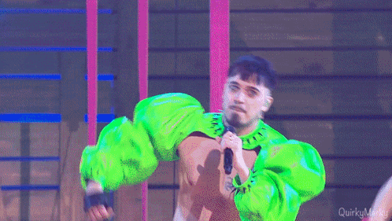


Slide 2
A geopolitical Analysis of the
Eurovision Song Contest Votes
Christopher Vogel - Data Analytics

Slide 3
Agenda
Who gives points to who?
Who gets the most points?
Effect of singular events
Conclusion

Slide 4
Introduction to the ESC
How does voting work?
Why do I care?
Each country awards 1-8, 10, and 12 points
One set as jury vote
One set as televote
Max. 24 points for one country
Big discrepancies between my own perception and jury votes

Slide 5

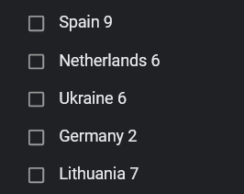
Ukraine 2022

Slide 6
How?

Slide 7
Potential Reasons
Political
Other
Political ties
Similar cultures
Geographic proximity
“The Big Five”

Slide 8
Who gives points who?

Slide 9
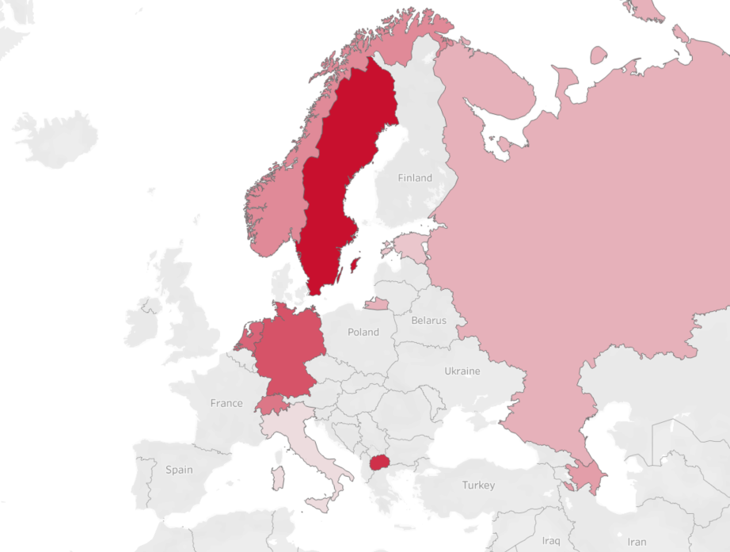
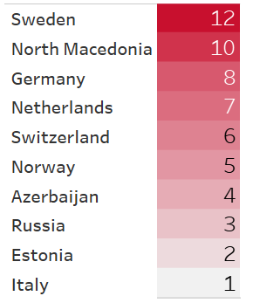
Denmark Jury Votes (2019)

Slide 10
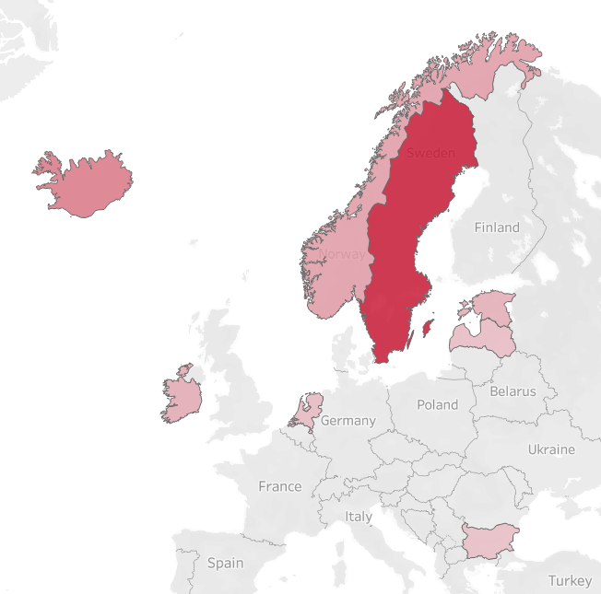
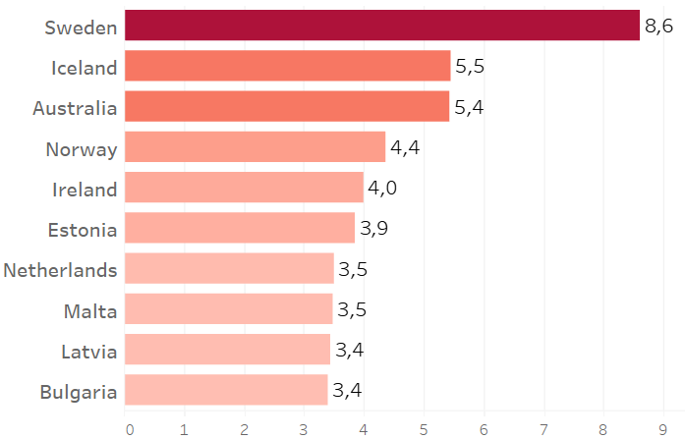
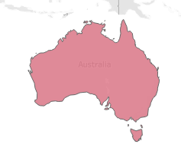
Denmark average Votes (1990-2023)

Slide 11
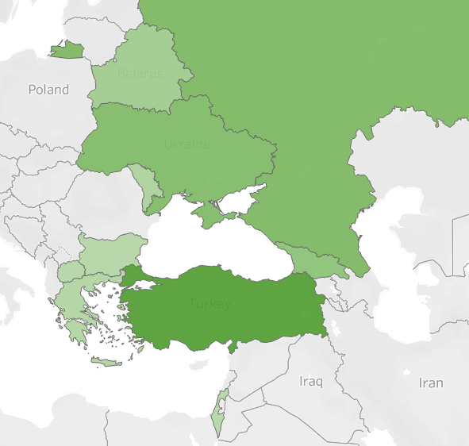
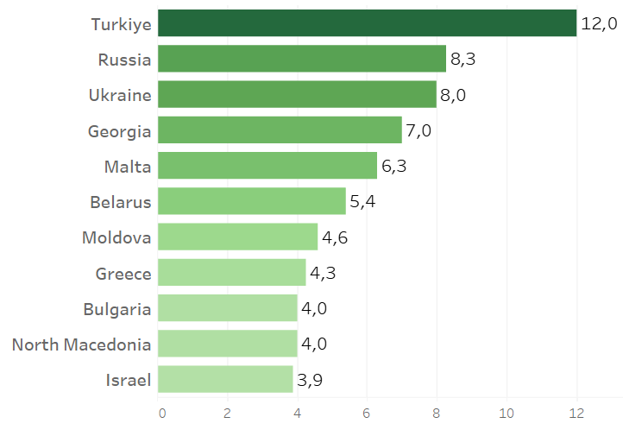
Azerbaijan average Votes (1990-2023)

Slide 12
Who gets the most points?

Slide 13
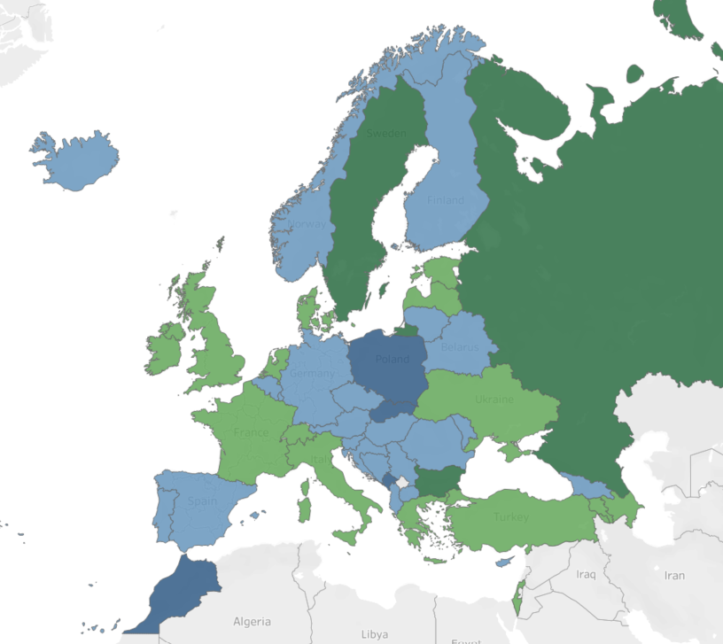
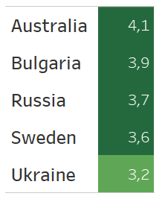
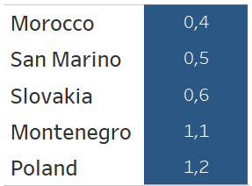
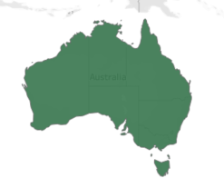
Average Jury Points received (1957-2023)

Slide 14
Do Events affect Voting?

Slide 15
Correlation does not equal Causation!

Slide 16

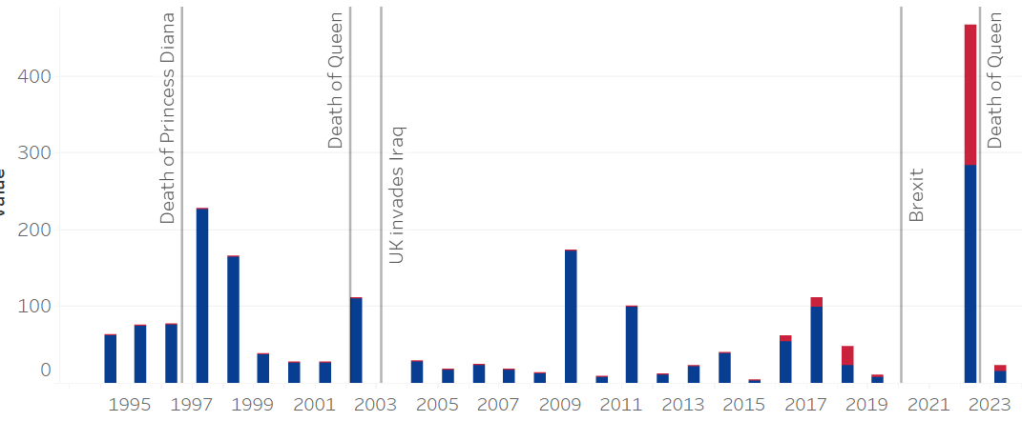
Timeline - United Kingdom

Slide 17

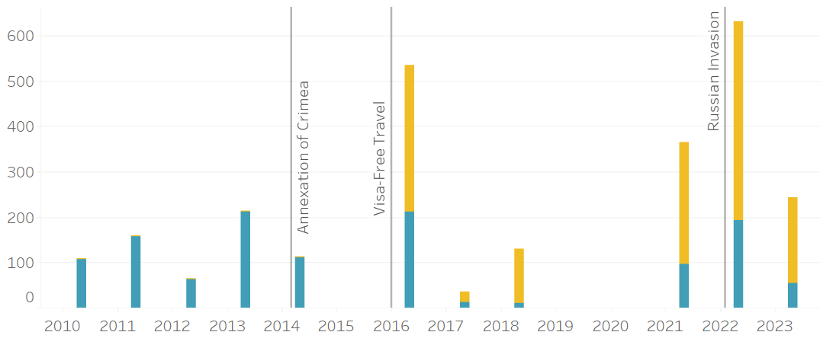
Timeline - Ukraine

Slide 18
Conclusions

Slide 19
Conclusions
Voting outcomes not solely based on performances
Influencing factors are complex
Prediction model using political events?

Slide 20
Final Score
Chris vs Bootcamp
1 - 0
Pesto Pandas Data

Slide 21
Thank You!
Pesto Pandas Data
Data Sources
https://eurovisionworld.com/eurovision/2022
https://zenodo.org/badge/latestdoi/214236225
https://eurovision.tv/about/facts-and-figures
Tech Stack
Python, Pandas, Tableau

